Slide 1

CENTRE FOR TRADE AND REGIONAL INTEGRATION
By: Dominique Njinkeu

Slide 2
Outline
I. INTRODUCTION
II. THE NEED FOR A CENTRE ON TRADE & NTEGRATION
III. THE MANDATE & FUNCTIONS OF THE CENTRE
IV. THE APPROACH OF THE PROPOSED CENTRE
  IV.1 TRADE POLICY & RESEARCH
  IV.2 A TRADE PRACTICE NETWORK
  IV.3 TRAINING & CAPACITY DEVELOPMENT
  V. GOVERNANCE & MANAGEMENT

Slide 3
I. BACKGROUND: THE CHALLENGES & OPPORTUNITIES
Over the past two decades, the African integration project envisioned by its leaders since the Abuja Treaty in 1991, witnessed a revival
Agenda 2063 provides a vision of “an integrated and prosperous and peaceful Africa, driven by its own citizens and representing a dynamic force in the international arena”.
Under this agenda, the Continental Free Trade Area (CFTA) is identified as one of seven pillars critical to ensuring an integrated and politically united continent

Slide 4
II. THE NEED FOR A CENTRE ON TRADE & INTEGRATION
  For developmental regionalism to materialize in Southern Africa numerous challenges need to be addressed
The intellectual foundation for African trade and regional integration has traditionally been shaped from outside the continent
The region needs a forward-looking research and policy support program grounded in African realities to adequately deal with the current changes in the trade agenda

Slide 5
II. THE NEED FOR A CENTRE ON TRADE & INTEGRATION
Promote African integration
CTRI
Collaborations in the areas of international trade and regional integration
Through an intensive applied
policy research & policy support programme
Train policy makers and other key players
    Facilitate and strengthen regional exchange
    Foster collaboration
    Promote knowledge sharing and South-South
    learning
Build peer-pressure coalitions of stakeholders &
relevant government bodies

Slide 6
III. MANDATE & FUNCTIONS OF THE CENTRE
The Centre will be a vehicle for articulating and promoting the African integration vision
First:
CTRI will inform African developmental regionalism through a focus on factors that nurture the trade-development nexus in Southern Africa and the rest of the continent
Second:
CTRI will seek to help the region organize itself to better influence the WTO’s governance; and overall engender trade rules that are supportive to African developmental regionalism
Third:
CTRI shall also inform policy efforts to create a modern age industrialization that is beneficial to both larger and smaller economies as well as large and small producers in Southern Africa
Fourth:
CTRI will leverage Southern African competitiveness to deepen regional integration

Slide 7
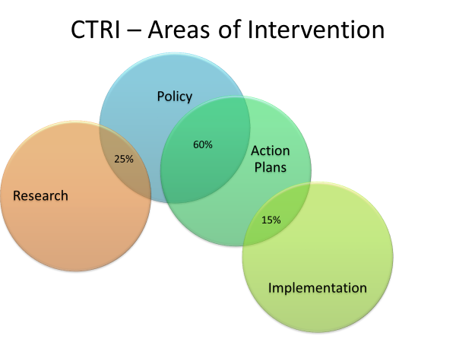

Slide 8
Objective:
  Nurture the policy and research interface through demand-driven policy research
  Empower policy makers with the capacity to translate research into policy
Challenges:
  There is a critical lack of understanding by researchers of the policy process, and the role their research can play in shaping policy
  There is an undersupply of policy relevant research, and data needed to generate analysis
  Trade negotiators and policymakers are often unaware of policy relevant research
  Trade and policy makers lack the capacity to translate research into policy
  IV.1 TRADE POLICY & RESEARCH
Ensuring Smaller Countries Benefit from Regional Integration

Slide 9
IV.1 ACTIONS
What role can the Centre for Trade and Regional Integration play in ensuring smaller countries benefit from the regional integration process ushered in by the TFTA and CFTA?
Cultivate a pool of specialist who are credible and able to advocate policies
Create a network that mobilizes relevant actors at all levels of the policy process
Nurture institutional incentives that foster change in the behaviour of policy makers
Retain and/or partner with relevant institution willing and able to champion policy proposals on developmental regionalism
Capitalize on researchers and networks on the continent and across the world that can assist in providing timely and strategic analysis that advances sustainable as well as developmental regionalism
Supporting the Research & Practice Network

Slide 10
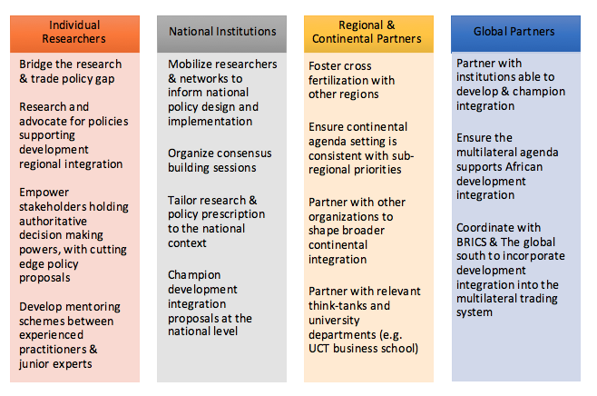
IV.1 TRADE POLICY RESEARCH NETWORK FOR AFRICA DEVELOPMENTAL INTEGRATION

Slide 11
Objective:
  Support policy implementation efforts and actions to unlock new investment opportunities
  Promote balanced growth across the Southern African Customs Union (SACU)
  Develop a platform focused on regional value chains to better balance trade between Southern African Countries
  Support a trade practice network that fosters cross-border trade facilitation
  IV.2 A TRADE PRACTICE NETWORK
Supporting Policy Reform Projects that Enhance Benefits for Smaller Countries

Slide 12
IV.2 ACTION
  Increasing the benefits to regional integration for smaller countries
  Develop policies to nurture a diversified export base
    Leverage South Africa’s scale as a demand engine and Gateway for developing robust global value chains and diversifying exports
    Harmonize border procedures along key corridors to Foster two-way trade beneficial to all countries
    Develop policies to address the challenges faced by firms seeking to grow to scale
  Strengthen the linkage between southern African multinational corporations and producers in smaller southern African countries
Supporting Policy Reform & Projects that Enhance the Regional Integration Benefits for Smaller Countries

Slide 13
IV.2 ACTION
  Build and maintain an inventory of comprehensive, comparable and up-to-date statistical information on SMEs
    Address the obstacles to building linkages
      This could consist of redressing information barriers
  Improve information flows on potential suppliers, purchasers and technology partners
          Improve information flows on potential suppliers, purchasers and technology partners
  Foster inter-firm subcontracting that enables regional producers to act as suppliers to south African firms to help establish collaborative supply relationships
Supporting Policy Reform & Projects that Enhance the Regional Integration Benefits of Smaller Countries

Slide 14
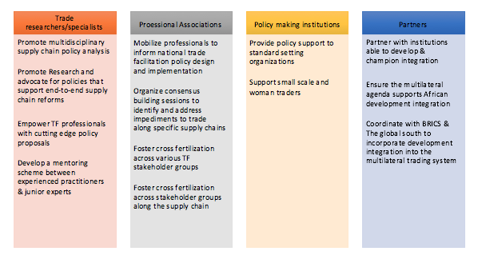
IV.2 A PLATFORM TO PROMOTE TWO-WAY TRADE

Slide 15
IV.2 ACTION
Support a trade practice network that fosters cross-border trade facilitation
Provide policy support to address logistical impediments along the supply chains to foster SME integration in regional and global value chains
  Support design and implement sector or product-specific processes that address the needs of smaller businesses
Strengthen Regional Border harmonization and operation efforts
  Support customs’ modernization programs throughout Southern Africa
  Support working groups that harmonize documents and procedures at borders
  Develop a centralized system that allows for a one stop trade information portal as a stepping stone to a full Single Window
  Extend the One Stop Border Posts and Coordinating Border Management
Streamline freight in the region including support to a regional freight billboard, policy support to SACU and SADC logistics liberalization efforts
Fostering Trade Facilitation Enhancing Benefits to Smaller Countries

Slide 16
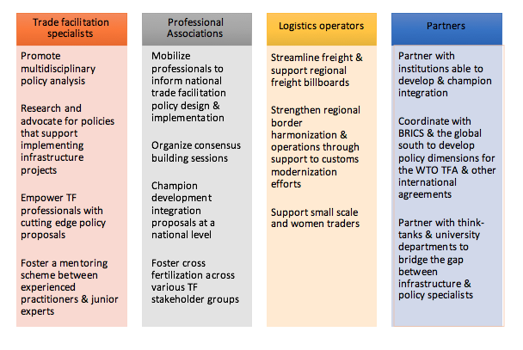
IV.2 A CROSS BORDER TRADE FACILITATION NETWORK TO
COMPLEMENT INVESTMENTS IN CROSS BORDER INFRASTRUCTURE

Slide 17
  IV.3 TRAINING & CAPACITY
  DEVELOPMENT
Objective:
Build the capacity of trade and regional integration practitioners
Equip current initiatives with an adequate coverage of the trade and integration agenda
Action:
Incorporate trade into national budget and public expenditure allocation
Enhance synergies with export and sector strategies by bringing on board national expertise and expertise within and across different agencies
    Align the trade agenda with national development processes and donor cycles
Training Trade Practitioners to Enhance the Regional Integration Benefits of Smaller Countries

Slide 18
IV.3 ACTIONS
Develop a package of training materials and resources that improve, coordinate and articulate regional skills development in support of industrialization
  This will consist of training in technical barriers to trade, with sanitary and phytosanitary barriers prioritized initially
Arrange partnerships with training institutions in Southern Africa (e.g. TRAPCA)
    Such programs will need to highlight a business perspectives
      Ex: the UCT business school the “Managing Infrastructure Reform and Regulation” program as well as through its Master of Commerce Degree program
Training Trade Practitioners to Enhance the Regional Integration Benefits of Smaller Countries

Slide 19
V. GOVERNANCE AND MANAGEMENT
CTRI
BOARD,
PROVIDES STRATEGIC GUIDANCE, STRATEGIC OVERSIGHT AS WELL AS MAINTAINS PRESTIGE & PUBLIC IMAGE
FINANCIAL CONTRIBUTORS-UNDP, THE DEPARTMENT OF TRADE & INDUSTRY OF SOUTH AFRICA, ETC.
CEO
MEMBERS AT LARGE
ADVISORY COMMITTEE
KEY STAKEHOLDERS- NATIONAL GOVERNMENTS, PROFESSIONAL ASSOCIATIONS, PRIVATE SECTOR & CIVIL SOCIETY
MANAGEMENT
ADMINISTRATIVE STAFF

Slide 20
CONCLUSION

