Slide 1
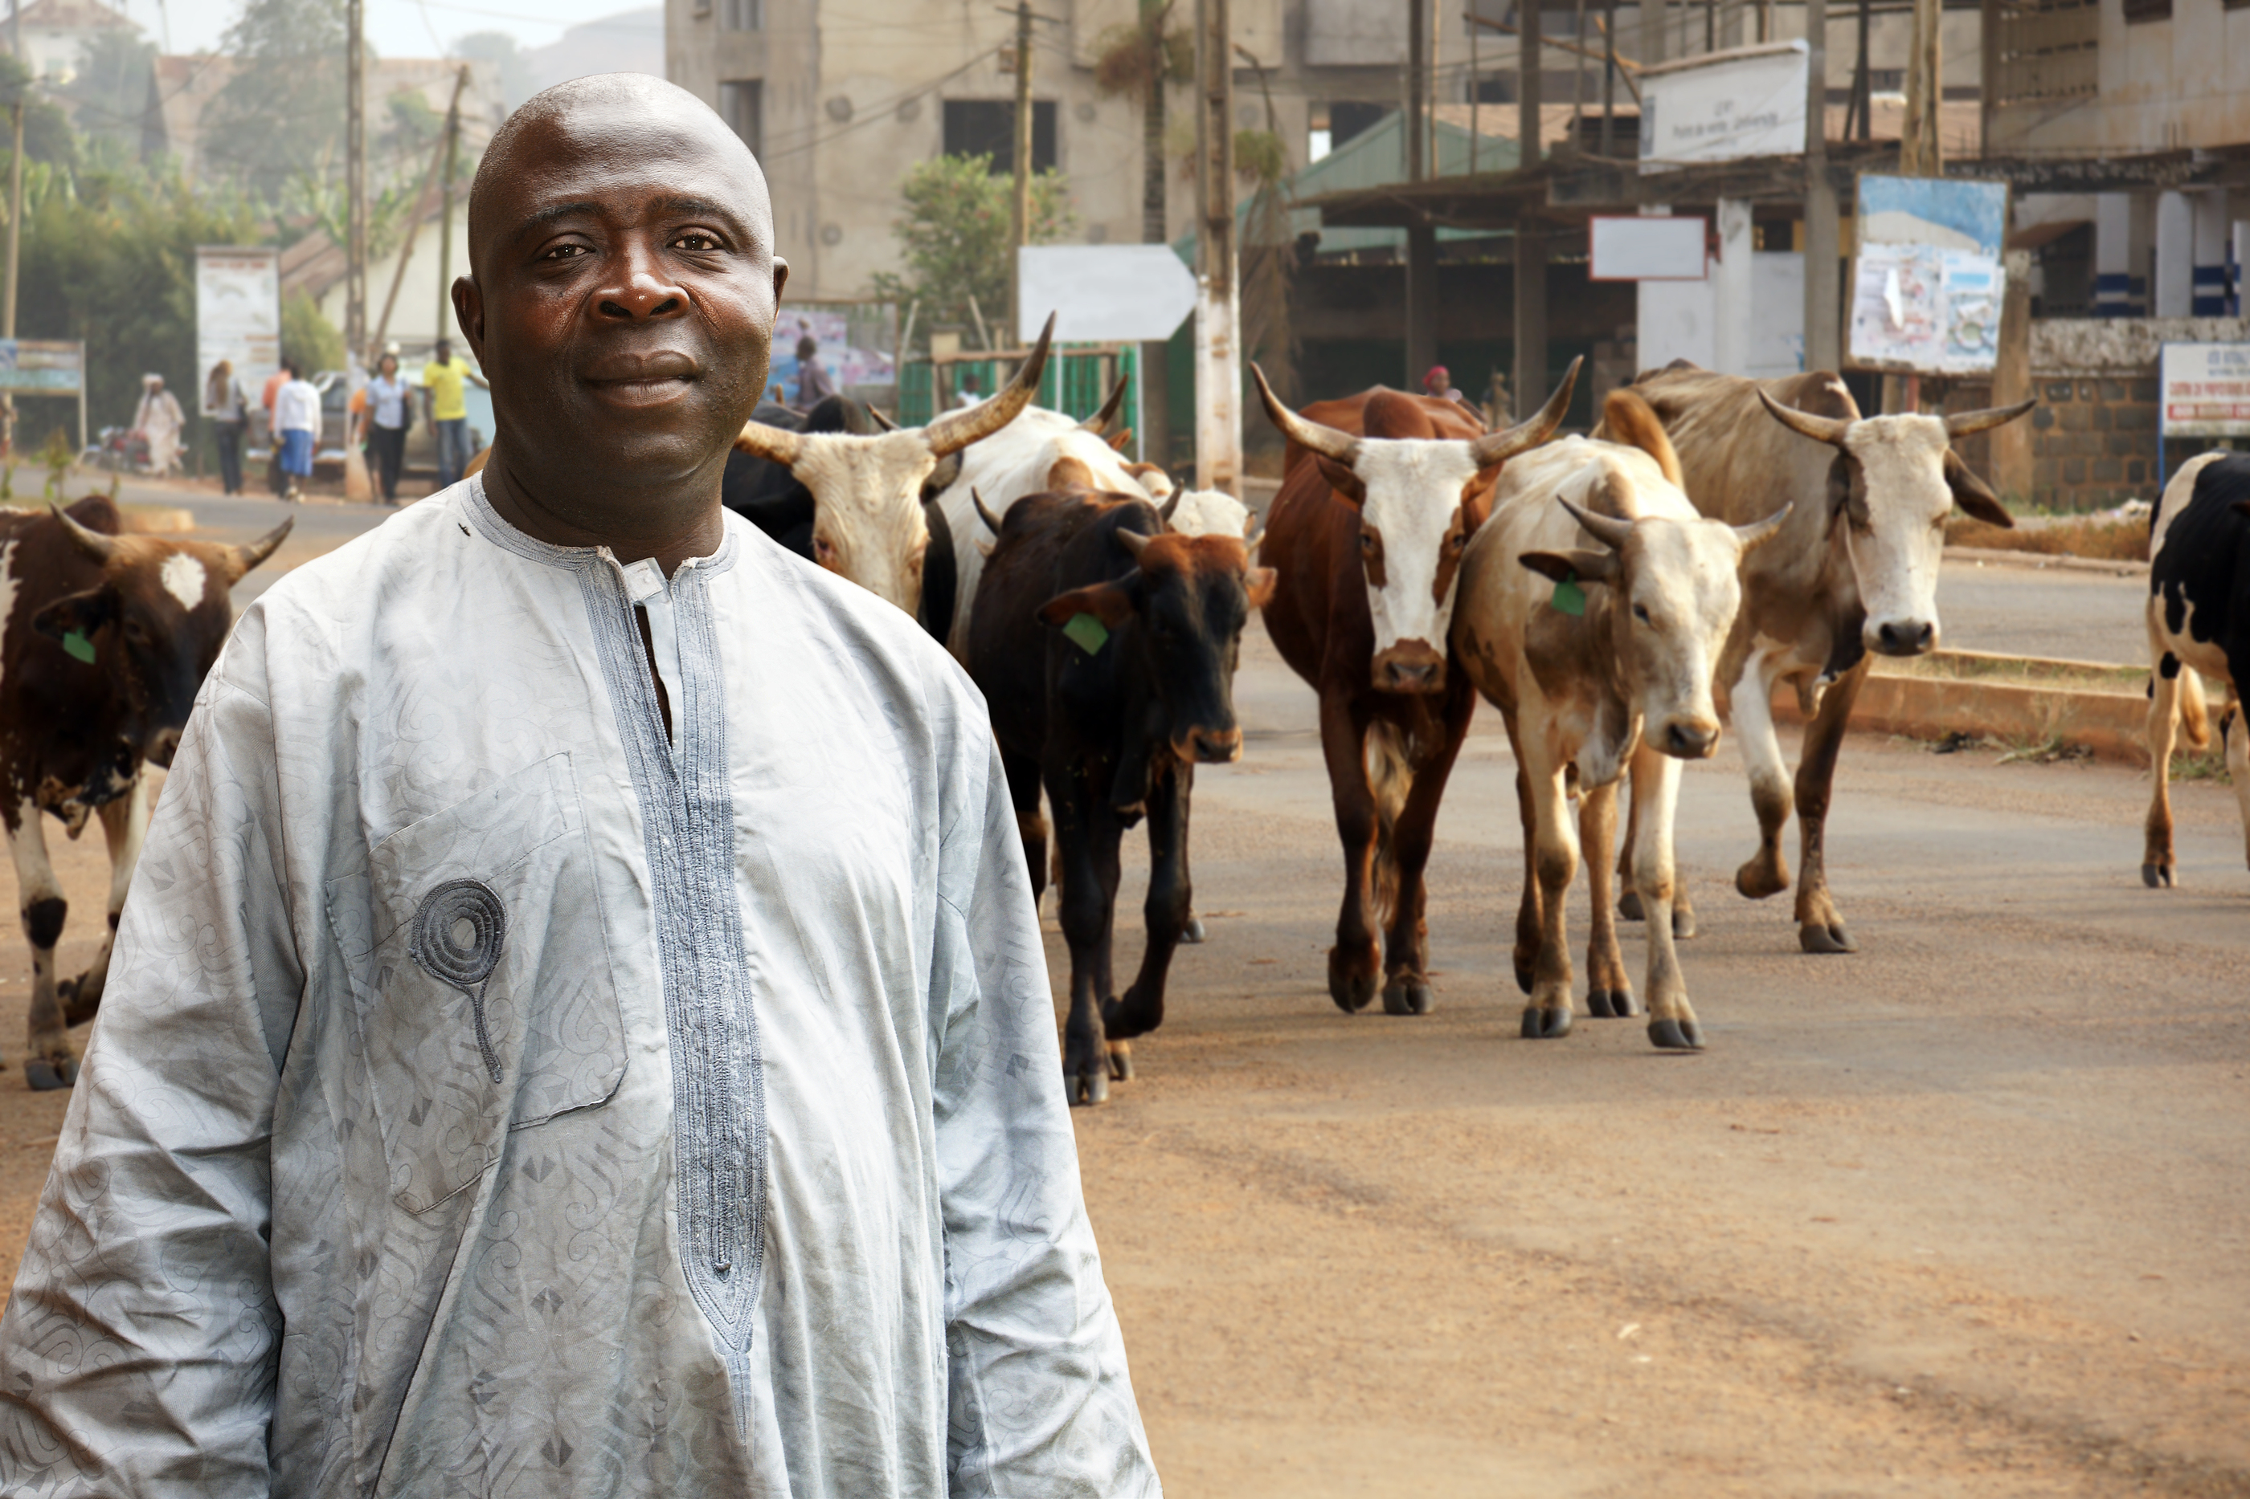

Value Chains and Agribusiness Development: Trends and Opportunities in Africa
Dominique Njinkeu, Executive Director, African Trade and Sustainable Development (AFTSD)
Symposium on the ACP New Approach on Support to the Agricultural Commodities Sector
Brussels February 23-24, 2017

Slide 2
I Introduction: Looking back and into the future
The focus on commodities in ACP has not been left Africa marginalized in world trade
The price and market guarantee schemes of the past will no longer be available to ACP
African Union Agenda 2063 prioritizes industrialization capitalizing on the development of agriculture and agribusiness

Slide 3
I. Introduction: Significant market potential, particularly at regional level
In 2030 the agriculture and agri-business in Sub-Saharan Africa is projected to expand into an economy of US$1 trillion
Opportunities to be harnessed through
  increasing financing to agriculture and agribusiness,
  but also regional and international trade

Slide 4
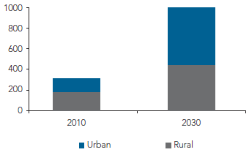
Food Market in Sub-Saharan Africa to explode
US$, billions
Source: Byerlee and Haggblade 2013.

Slide 5
II. ADDRESS THE FINANCING GAP
Agribusiness contributing to a growing percentage of GDP
Funding the main Achille heel of the agricultural sector Africa
African governments channel 4 % of government investments towards agriculture and agri-business
Africa needs over USD $11billion in financing agriculture and agri-business
Source: World Bank and documents from Central Banks of Côte d’Ivoire, Ghana. Nigeria, and Sierra Leone.

Slide 6
Share of Agriculture in Total Lending and GDP in Selected Countries
Source: World Bank and documents from Central Banks of Côte d’Ivoire, Ghana. Nigeria, and Sierra Leone.
World Bank. (2016). Financing Agribusiness in Sub-Saharan Africa: Opportunities, Challenges and Investment Models. Washington DC: The World Bank Group

Slide 7


MULTI-PRONG APPROACH
Access to Finance
Cost of accessing finance is high
Bank Lending procedures are burdensome
Quality of Finance
Mismatch between the length of loans and the needs of the agri-business actor
Lending risk
Potential profit is the major considerations for lending
Financial Infrastructure
Financial service providers rely on these institutions to analyze risk, process applications and provide financial products
Variety in Financing
Banks tend to provide traditional products
Innovative lending, risk management and distribution tends to be limited
In cases where innovative services are available, the clients have limited knowledge of the product and how it is used

Slide 8
Adequate policy to ensure efficiency of financial
Access to Services
Cost of accessing available services is high
Some types of services are not available
Quality of Services
Mismatch between the offered services and the needs of the agri-business actor
Productivity
Agricultural productivity is the major considerations for the use of services as inputs
Backbone Services
access to communication, electricity and financial services are significant determinants of total factor productivity
Variety in Services
Formal services providers tend to provide traditional products
Innovative lending, risk management, logistic and distribution services tends to be limited
Other services such as access to reliable and affordable electricity and longer term investment loans have an important impact on farm’ ability to adopt new technologies and finance innovation
availability of some types of services can constitute an element of comparative advantage and thus influence agricultural export composition

Slide 9
III. THE OPPORTUNITIES FOR AGRICULTURE & AGRIBUSINESS OFFERED THROUGH TRADE
Regional Trade has the potential to facilitate entry for small producers seeking to participate in regional food and agricultural trade
  Integration can expand intra-African trade from 10.2 % to 15.5 % between 2010 to 2022 if implemented in conjunction with trade facilitation
  Increased access to African markets:
    Helps level the playing field between African producers as well as foster transnational agro-business firms
    Enables and provides the environment for farmers to diversify beyond low-income household production

Slide 10
III. THE OPPORTUNITIES FOR AGRICULTURE & AGRIBUSINESS OFFERED THROUGH TRADE
Regional Trade creates opportunities for more sophisticated regional value chains that accelerate diversification
  RVC can also create the environment for new labour-intensive industries that generate new employment
  The trickle down effects of tariff and non-tariff barrier reforms foster long-term improvements of the capacity to produce

Slide 11
IV. CONCLUSIONS: AMENDMENTS TO THE BACKGROUND SECTION
Background section (II) to include review of trade in agricultural commodities in regional integration programs, in the Continenatl Free Trade Area (CFTA), in bilateral trade regimes (EPA) and in multilateral trade negotiations. The focus should be to ensure a coherent approach is followed
Paragraph 12 amended to take into account the capacity to trade
Paragraph 13 amended to expand from rural infrastructure and discuss the broad trade facilitation agenda
Paragraphs 16 and 17 amended to account for the trade dimension.

Slide 12
IV. CONCLUSIONS: AMENDEMENT TO POLICY OPTIONS SECTION
New approach on four options: finance, capacity building, climate; trade
A paragrah on multilateral, bilateral and regional trade agenda in support of value chains and agribusiness
A paragraph on policy reform to ensure access to affordable finanances by small and medium scale producers and consumers
A para on NTB, in line with Article 31 of the Abuja Treaty and the AU 27th Ordinary Session of of July 2016 on the elimination of NTB.

Slide 13
IV. CONCLUSIONS: AMENDEMENT TO POLICY OPTIONS SECTION
A paragraph on aid for trade to support practical mechanisms for eliminating NTB
A paragraph on policy reform to enable efficient financial products, cross-border, and international trade
A paragraph on the trade in services agenda as an enabler of agribusiness development.
A paragraph on nurturing an ACP training and research capacity

Slide 14
Thank you very much
Merci beaucoup
Dominique Njinkeu, Executive Director, African Trade and Sustainable Development (AFTSD)
Email: dnjinkeu@outlook.com
Website: www.afrtsd.org

