Slide 1


Implementing Regional Trade Agreements
DOMINIQUE NJINKEU, Brussels February 3, 2017

Slide 2
OUTLINE
Introduction
Message 1: Huge opportunities in agriculture
Message 2: Opportunities hampered by borders
  Harness trade facilitation
  Focus on trade in services component of agriculture
  Empower stakeholders
CONCLUSION

Slide 3
I. INTRODUCTION
Trade agenda at the cross-road: CFTA +
Opportunities offered by the free trade agreements at regional and continental level in Africa
Harness these opportunities to increase market shares for value chain actors
Highlight the benefits for the agricultural and the service sector

Slide 4
IV. OPPORTUNITIES HAMPERED BY BORDERS
OPPORTUNITIES
Focus on trade facilitation
Servicification of agricultural production and trade
Stakeholders empowerment and coalition building

Slide 5
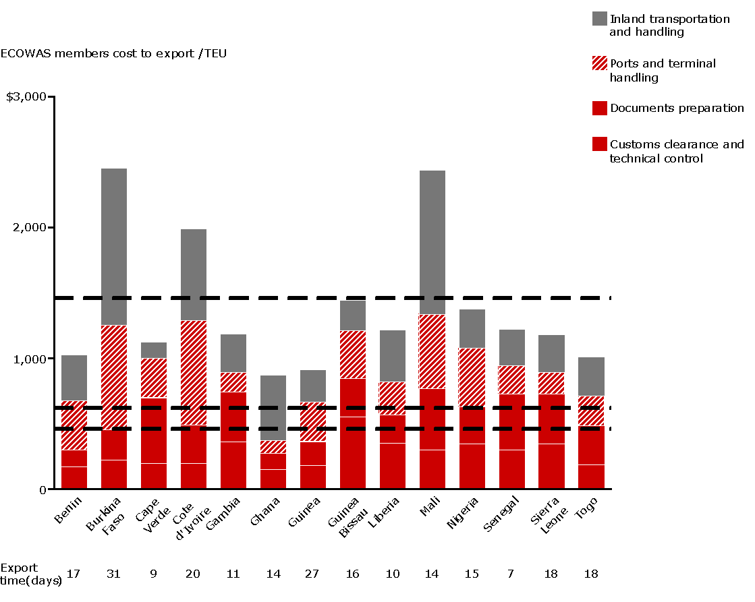
IV.A TRADE FACILITATION CLUSTER of BIAT
Partial focus of the TFA
KEY TAKEAWAYS
Cost to export doesn’t include business environment or security costs
Focus of the TFA
The TFA only applies to a portion of the cost to export
  Most resources may only address customs/doc prep which is only part of the solution
Cost to export should also include business environment costs (e.g., regulations, security)
Total export cost (benchmarks)
Emerging markets
China
Singapore
Need a coherent and integrated program to address total
cost to export
Source: World Bank “Doing business”
Notes:
World Economic Forum Enabling Trade Integration Index

Slide 6
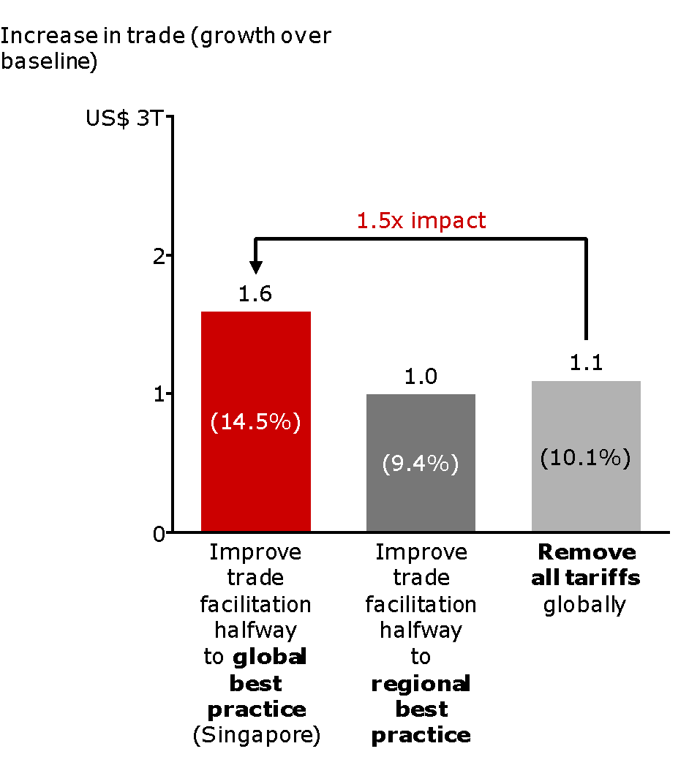
IV.A. FOCUS ON KEY SUPPLY CHAINS
IV.A. FOCUS ON KEY SUPPLY CHAINS
REMOVING SUPPLY CHAIN BARRIERS HAS A SIGNIFICANT IMPACT ON TRADE…
DRAMATIC IMPACT ON GDP
Note: Based on export value; includes only the effect of “Border Administration” and “Telecommunication and Transport Infrastructure”
Source: Bain & Company; Ferrantino, Geiger and Tsigas, The Benefits of Trade Facilitation - A Modelling Exercise; Based on 2007 Baseline
Notes:
Reducing supply chain barriers has a 6x larger effect on GDP and trade than removing tariffs

Slide 7
IV.B. SERVICIFICATION OF AGRICULTURAL SECTOR
Servicification
  Strong links between services and production
  Strong links between services and exports activities
  Structure of services and their links to domestic economy or exports activities differs: country-specific features matter
  Understand the degree to which agricultural production and trade dependent on five service industries (e.g. transport, communication, finance, insurance, other business services & ICT)

Slide 8
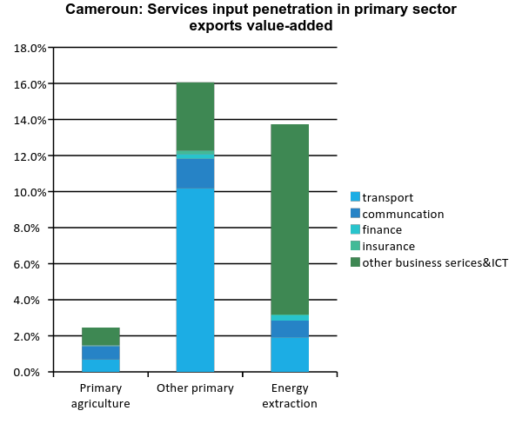
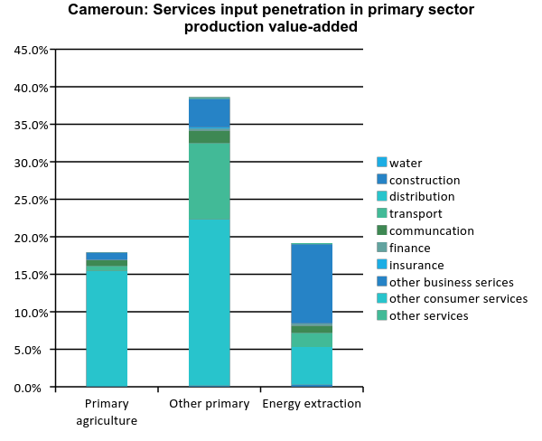
SERVICES INPUT PENETRATION IN THE PRIMARY SECTORS IN CAMEROON
Source: Export of Value Added Database

Slide 9
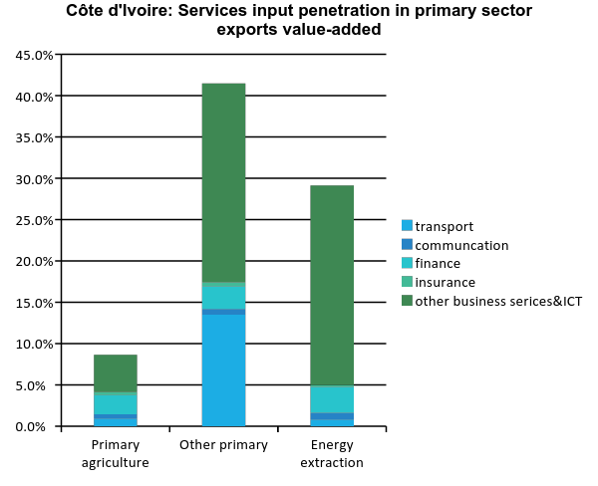
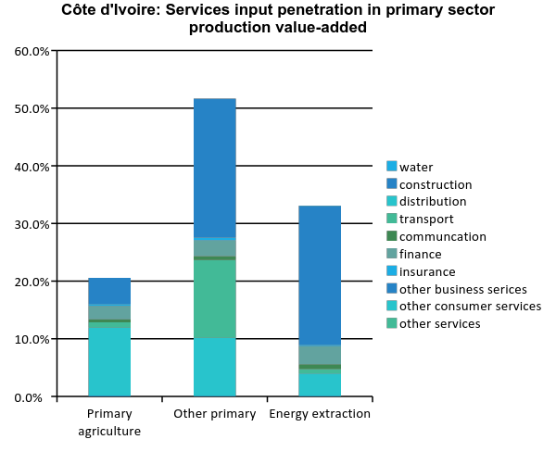
SERVICES INPUT PENETRATION IN THE PRIMARY SECTORS IN CÔTE D’IVOIRE
Source: Export of Value Added Database

Slide 10
IV.C. Multi-stakeholders coalition to achieve concrete and measurable results
Stakeholders
Three levels of implementation support
Ministries: industry, trade, regional integration, agriculture, transport
High-level support and coordination
Share lessons and best practices
  Analytical support to explore costs and benefits of process re-engineering
  Advisory support for mainstreaming in development agenda
  Facilitate private sector involvement and industry-specific expertise sharing
1
Regional and continental structures
Private sector , industry-specific and logistics
Harness opportunity of regional and international trade
  Development of sector strategies for production and trade
  Innovative ideas to dismantle NTB
  Build and sustain coalitions for trade development
  Training and capacity development to harness opportunities
2
Research, training, civil society
Deep national implementation
  Perform a detailed diagnostic to inform industry focus, definition of initiatives, and resource allocation
  Oversee day-to-day project management, ensuring timely progress against goals
  Ensure a smooth change management process across various stakeholders
Development partners
3

Slide 11
VI. CONCLUSION

Slide 12
IV.D HARNESSING POTENTIAL IN REGIONAL MARKET
CONTEXT
SPECIFIC SECTOR GAPS
Agric-based industry
  Palm Oil ;Poultry ; meat; Fisheries
  Sugar; Cereals; Cassava
Light manufacturing
  Textile, apparel and leather products
  Furniture and equipment
  Pharmaceutical and chemical products
  Fuel products
  Machines and automotive
Heavy manufacturing
  Construction
Additional opportunities may exist based on benefit of a regionally integrated market (e.g., Cocoa in a joint effort by Cote d’Ivoire, Ghana, Nigeria, and Cameroon)
Free movement area since 2000
New CET 2015
CFTA by 2017
Regional Market regulation tools on the way (quality and standards, common code of investment, commercial defence etc.)
Business climate improvement programs
REGIONAL GAP FOR
REGIONAL MARKET
NEEDS
Develop the industry to feed the gap of regional needs in many sectors
Use the provisions of the Common External Tariff (CET) to promote strategic sectors on 5th and 4th tariff bands
Integrate the region within the global supply chain to feed the regional market by contracting with main industry and distribution players
Massive importation of manufactured products
Low level of regional industry. Manufacturing industry accounted for a mere 7.36 % of the regional GDP of 2001.
Regional products unknown by big distributions and industry chains

Slide 13
IV.D BENCHMARKING BASED ON ENABLING TRADE INTEGRATION INDEX TO HARNESS OPPORTUNITIES IN INTERNATIONAL MARKETS
CONTEXT
SPECIFIC SECTOR GAPS
Economic Partnership Agreement (EPA) negotiations concluded
Further opportunities are on their way e.g. US Congress expected to renew and improve the African Growth and Opportunity Act (AGOA)
More and more demand of products from China and emerging countries
WTO negotiations
Coherence
Agro industry transformation
  Cashew
  Mango
  Shea butter
  Cocoa
  Rubber
  Cotton
  Wood
Other sectors
  Textile
  Furniture
  Construction
  Vehicles
  Chemicals
  Fuel,
  Services
REGIONAL GAP FOR INTERNATIONAL MARKET
Less than 12% of products processed before exportation
Low level of manufactured products exported to EU market under Cotonou Agreement
Low level of manufactured products exported to US market under AGOA
Regional manufactured products unknown by big distributions and industry chains
No strategy to link bilateral trade agreements with industrialization through supply chain
NEEDS
Strategize on market supply chain
Attract investment
Attract big player of distribution and industry players

Slide 14
OPTIMIZATION STRATEGY OF MARKET ACCESS TO BE NEGOTIATED BY CFTA
Coherent trade policies for agro-based industrialization: EPA, WTO, AGO
Create a unified and vibrant market
    Implement the regional programs
    Dismantle intra-regional barriers: NTB monitoring
Proactively implement trade facilitation program; particularly prioritize value-chains where wealth can be created

Slide 15
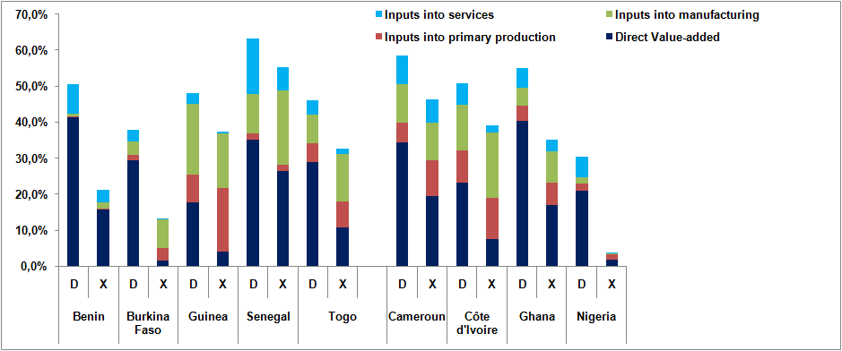
SERVICE LINKAGES TO OTHER
ECONOMIC ACTIVITIES AND TO EXPORTS
services major component of export activity and cross-border trade
fastest growing segments of the world economy
Structure country-specific
Source: Export of Value Added Database.
Note: D = Domestic value-added; X = Export value-added

Slide 16
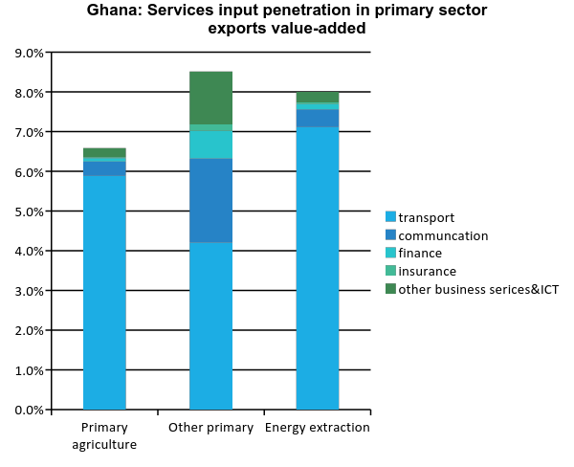
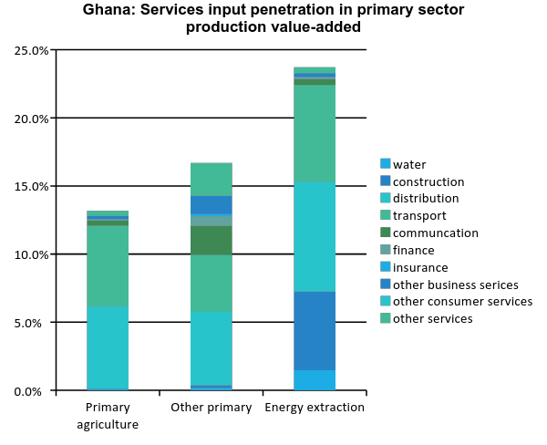
SERVICES INPUT PENETRATION IN THE PRIMARY SECTORS IN GHANA
Source: Export of Value Added Database

Slide 17
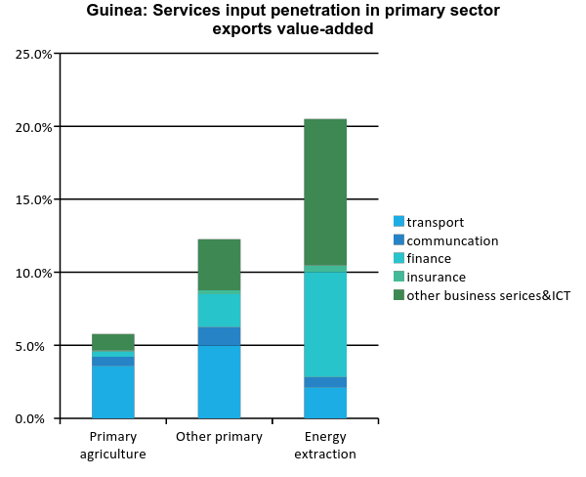
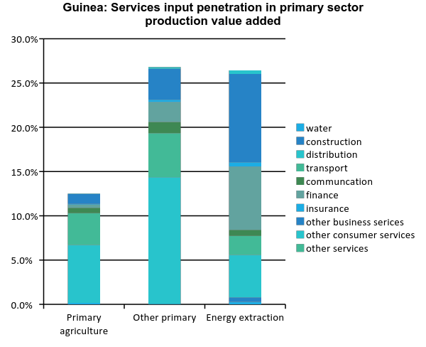
SERVICES INPUT PENETRATION IN THE PRIMARY SECTORS IN GUINEA
Source: Export of Value Added Database

Slide 18
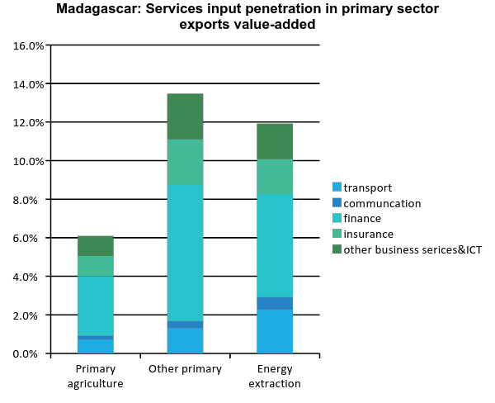
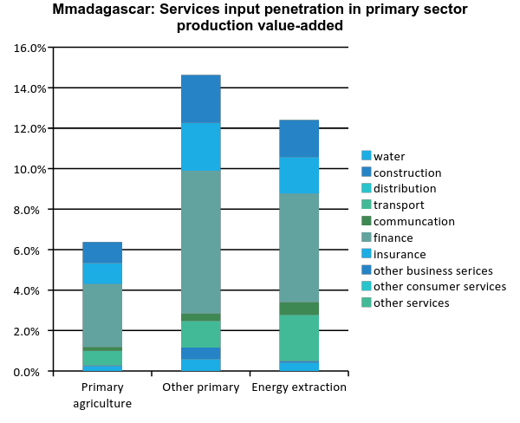
SERVICES INPUT PENETRATION IN THE PRIMARY SECTORS IN MADAGASCAR
Source: Export of Value Added Database

Slide 19
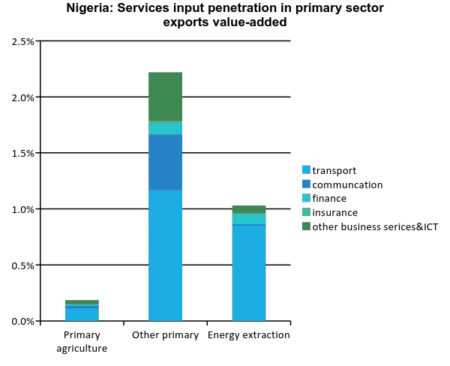
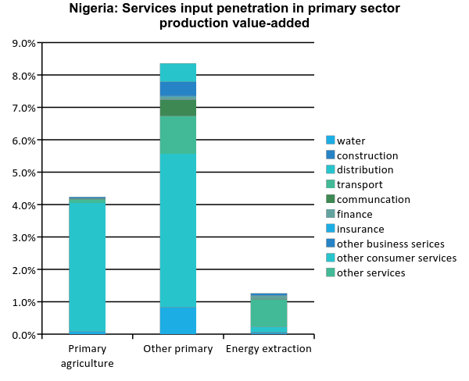
SERVICES INPUT PENETRATION IN THE PRIMARY SECTORS IN NIGERIA
Source: Export of Value Added Database

Slide 20
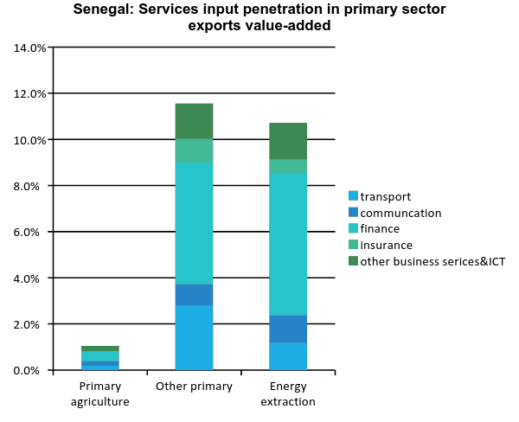
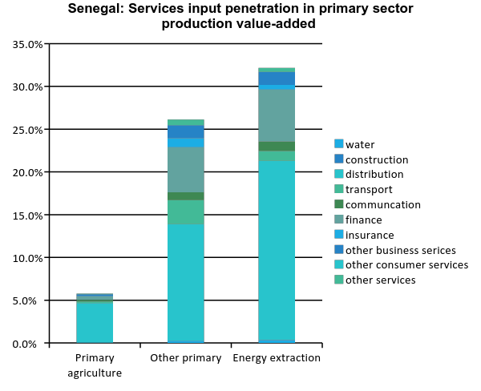
SERVICES INPUT PENETRATION IN THE PRIMARY SECTORS IN SENEGAL
Source: Export of Value Added Database

Slide 21
IV.C STAKEHOLDERS EMPOWERMENT
Political economy
Research and training
Coalition building
Notes:
BUILDING ON ATW2016 SESSIONS

